Slide 1
Customer Analytics Logistic regression, churn management

Slide 2
Agenda
Case: proactive churn management
Logistic regression
Deviance & R²
Overfitting and cross-validation
ROC/Lift curves
Optimal targeting

Slide 3
Churn management
Blattberg, Kim and Neslin (2008) Ch. 24

Slide 4
from lecture 1: Customer lifecycle
Customer development: change in behavior over time: buying more (up-selling) or different things (cross-selling)
Customer acquisition:
how customers are “born” or first contact with the firm.
Customer retention: preventing customer “death” or churn.
Marketing is about acquiring, developing and retaining customers
Notes:
Customers go through stages in their relationship with the firm.

Slide 5
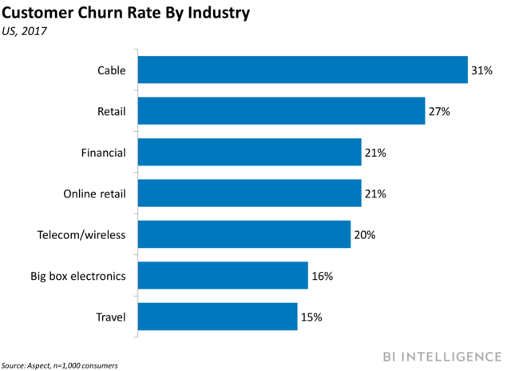
Case: preventing churn
Customer churn (customer quitting)
Typically, it is cheaper to retain existing customers than to acquire new customers

Slide 6
Case: proactive churn management
Reactive churn management
Customer already almost out of the door
Proactive: identify customers who have high probability of churning.
Need model to predict churn
Contact customer ahead of churn (quit)
Offer incentive or service to prevent customer from churning

Slide 7
How can companies predict who will churn?
Use model to predict quit or stay based on all variables you have at your disposal
Past usage
Contract type
Marketing
Demographics
Use the results of this model to predict likelihood of quitting for new/current customers.

Slide 8
Logistic regression
Blattberg, Kim and Neslin (2008) Ch. 15: 377-85
Quantitative_Models_in_Marketing_Research: Chapter 4, a binomial dependent variable

Slide 9
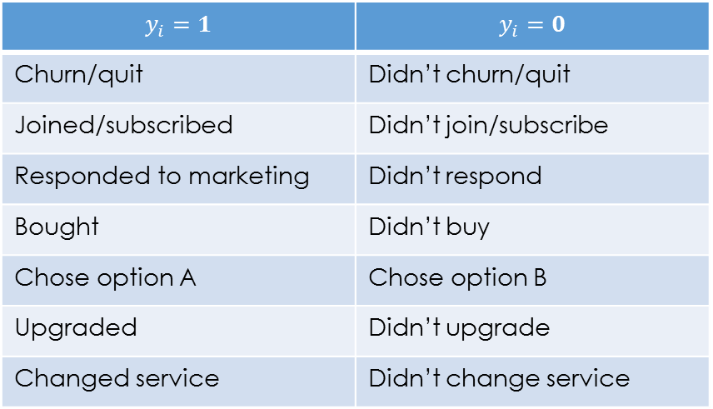

Modeling response
examples
Dependent variable is binary
$$Y∈\left\{0 ,1\}\right.$$
$$y_{i}=1$$ | $$y_{i}=0$$
Churn/quit | Didn’t churn/quit
Joined/subscribed | Didn’t join/subscribe
Responded to marketing | Didn’t respond
Bought | Didn’t buy
Chose option A | Chose option B
Upgraded | Didn’t upgrade
Changed service | Didn’t change service
Mutually exclusive: can’t be both
Collectively exhaustive: can’t be neither
Arbitrary what we call “1” and “0”

Slide 10

Modeling the probability
$$P\left(Y=1\right)=\frac{\exp\left(S\right)}{1+\exp\left(S\right)}$$
$$S=β_{0}+{\sum_{j=1}^{p}{{ β}_{j}X_{j}}= β}_{0}+β_{1}x_{1}+β_{2}x_{2}+β_{3}x_{3}+…β_{p}x_{p}$$
$$\exp\left(1\right)=e≈2.72$$

Slide 11


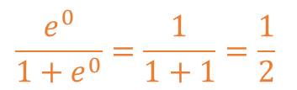
Logistic “S” curve
flattest at min and max
$$P\left(Y=1\right)$$
Steepest in the middle
$$\frac{e^{0}}{1+e^{0}}=\frac{1}{1+1}=\frac{1}{2}$$
$$S$$
flattest at min and max
Notes:
Maps real line of numbers to the [0,1] space of probabilities.

Slide 12

Linear model for log odds
$$\log\left(\frac{p}{1−p}\right)=β_{0}+β_{1}x_{1}+β_{2}x_{2}+β_{3}x_{3}+…β_{p}x_{p}$$
where $p=P\left(Y=1\right)$.
$$p=\frac{1}{4} ⇔\frac{p}{1−p}=\frac{1}{3}$$
Generalized linear models
$$g\left(μ\right)=β_{0}+β_{1}x_{1}+…$$
where $μ$ is the mean and $g\left(μ\right)$ is the link function.

Slide 13
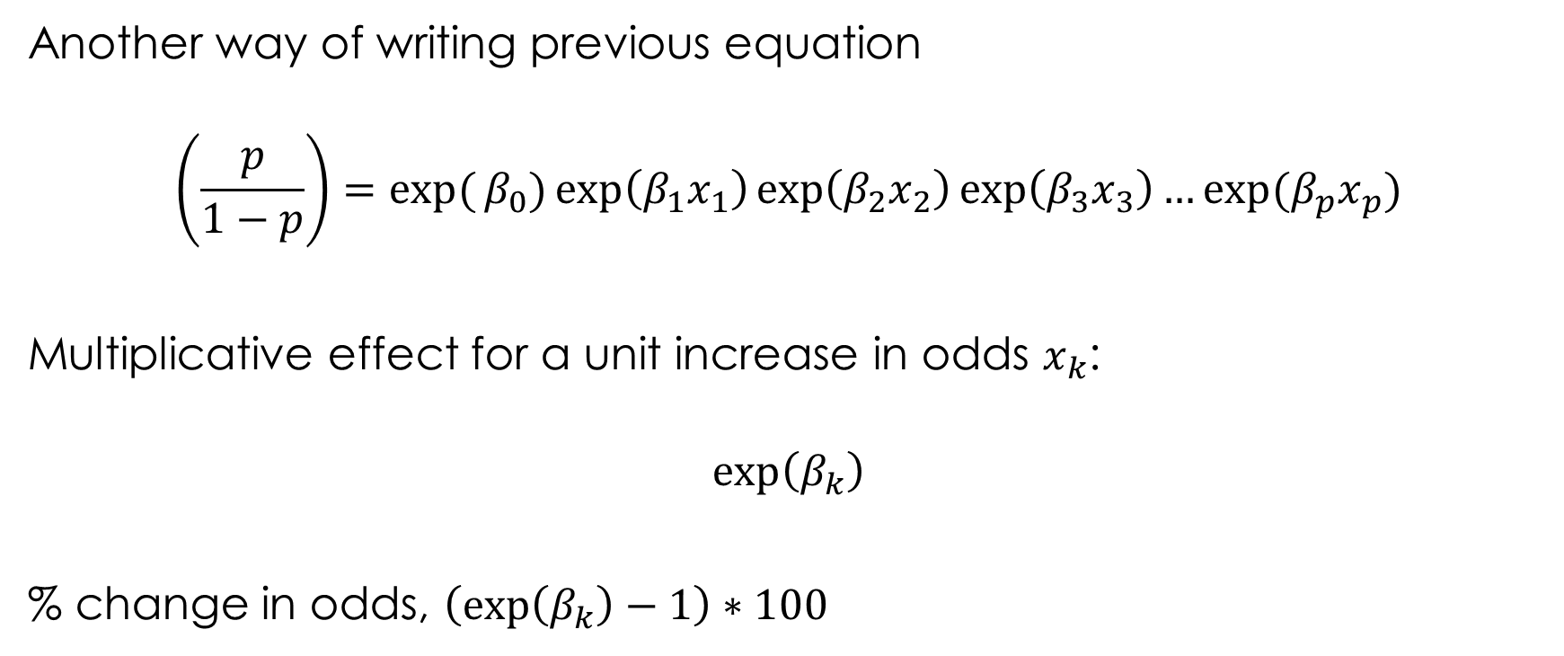
Multiplicative effect on odds
Another way of writing previous equation
$$\left(\frac{p}{1−p}\right)=\exp{(}β_{0})\exp\left(β_{1}x_{1}\right)\exp\left(β_{2}x_{2}\right)\exp\left(β_{3}x_{3}\right)…exp⁡(β_{p}x_{p})$$
Multiplicative effect for a unit increase in odds $x_{k}$:
$$exp\left(β_{k}\right)$$
% change in odds, $\left(exp\left(β_{k}\right)−1\right)∗100$

Slide 14
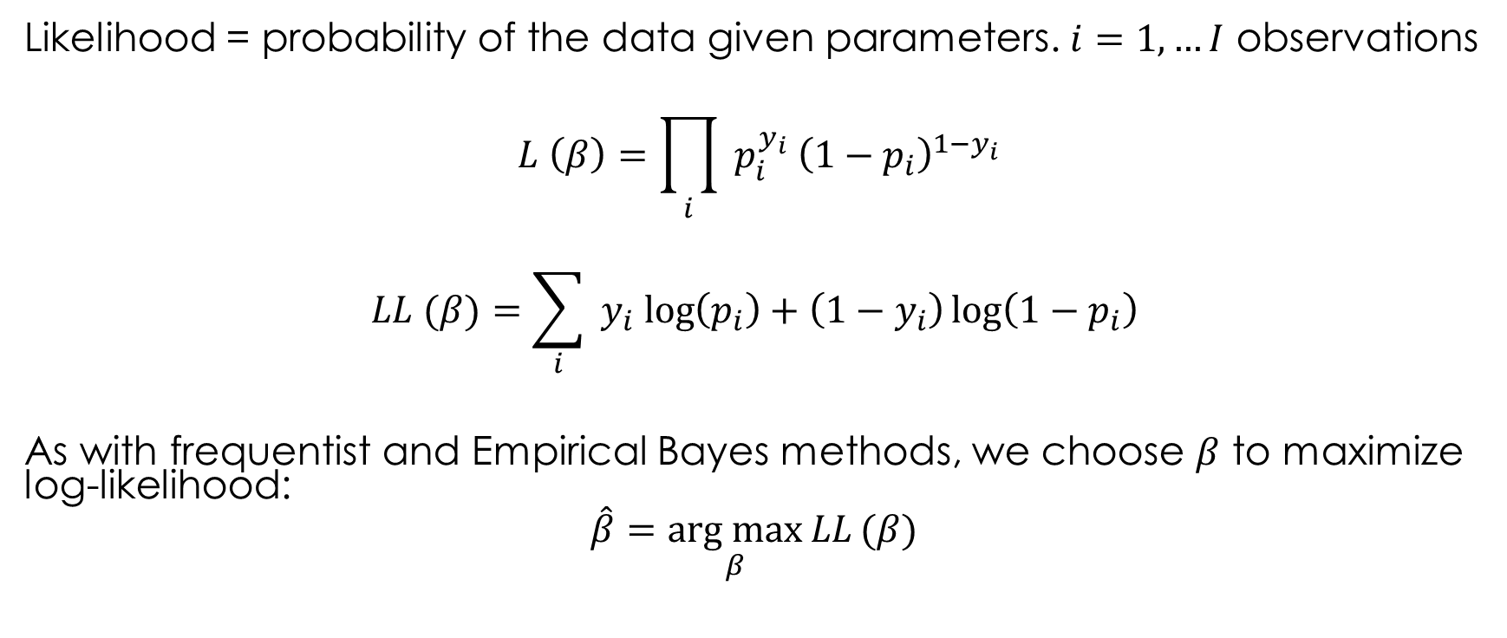
Maximum Likelihood Estimation
Likelihood = probability of the data given parameters. $i=1, …I$ observations
$$L \left(β\right)=\prod_{i}{ p_{i}^{y_{i}} {\left(1−p_{i}\right)}^{1−y_{i}}}$$
$$LL (β)=\sum_{i}{{ y}_{i}\log\left(p_{i}\right)+\left(1−y_{i}\right)\log\left(1−p_{i}\right) }$$
As with frequentist and Empirical Bayes methods, we choose $β$ to maximize log-likelihood:
$$\hat{β}=\underset{β}{\text{arg} \text{max}}{LL}(β)$$
Notes:
Give if y = 1 or 0
Outliers
Separating hyperplane

Slide 15
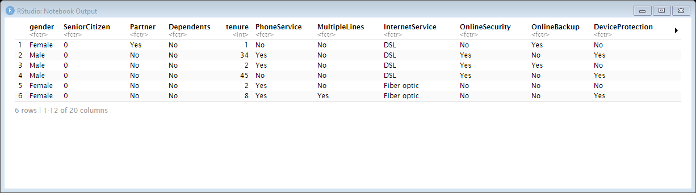
Telco churn (inspecting)
7000 obs., 20 variables

Slide 16
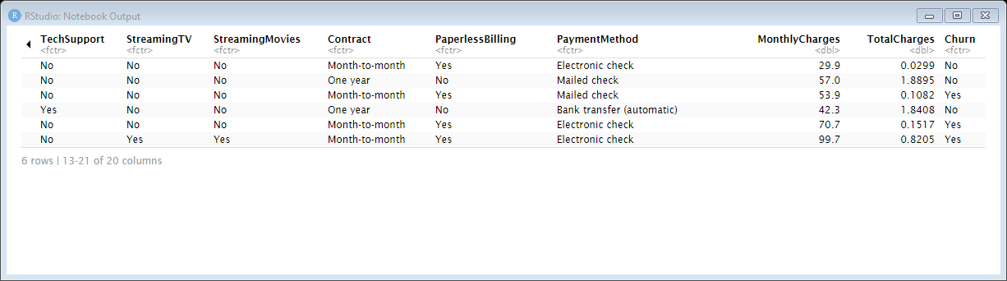
Telco churn
Notes:
every variable categorical except charges and tenure

Slide 17
Notes:
tenure p_churn n_churners n p_churn_se lower_CI_pchurn upper_CI_pchurn
<dbl> <dbl> <dbl> <int> <dbl> <dbl> <dbl>
1 1 0.620 380 613 0.0196 0.581 0.658

Slide 18

Model 0:
$$y=\left\{\begin{aligned}0, \text{Churn}="\text{No} " \\ &1, \text{Churn}="\text{Yes}"\end{aligned}\right.$$
$$P\left(\text{y}=1\right)=\frac{\exp\left(β_{0}+β_{1} \text{Tenure}\right)}{1+\exp\left(β_{0}+β_{1} \text{Tenure}\right)}$$

Slide 19
Notes:
0.5

Slide 20
Notes:
sqrt(t(C) %*% vcov(o) %*% C)
1x2
.04
Variance reduction,

Slide 21
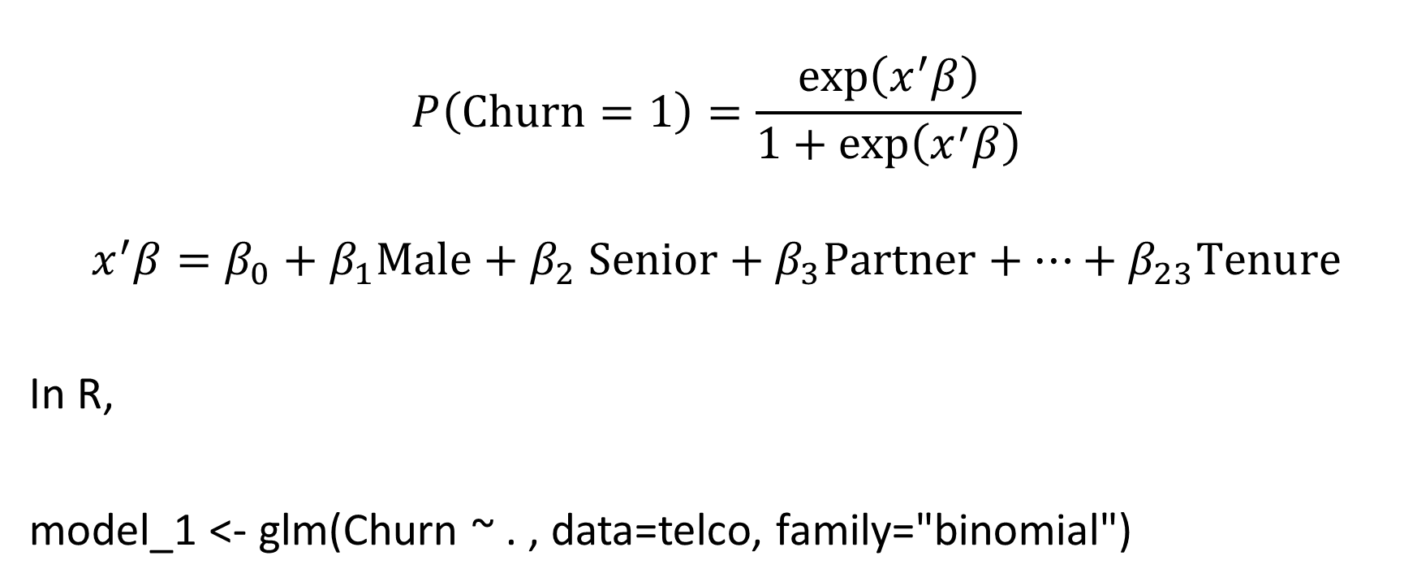
Model 1
$$P\left(\text{Churn}=1\right)=\frac{\exp\left(x^{′}β\right)}{1+\exp\left(x^{′}β\right)}$$
$$x^{′}β=β_{0}+β_{1}Male+β_{2} \text{Senior}+β_{3}\text{Partner}+…+β_{23}\text{Tenure}$$
In R,
model_1 <- glm(Churn ~ . , data=telco, family="binomial")
“everything else”

Slide 22
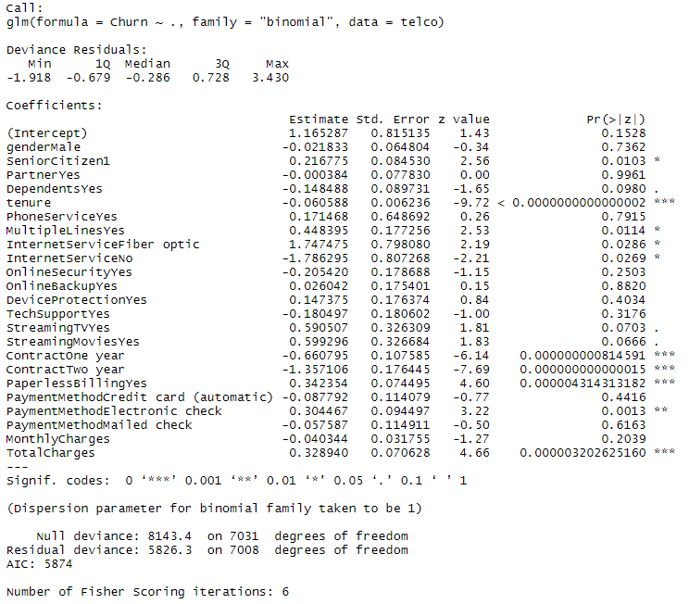
Face validity:
Do the signs of significant coefficients make sense?
Notes:
Z-value = est/se -> greater in abs than 2
P-value
Especially with what we saw about the univariate relationships between churn and tenure.

Slide 23
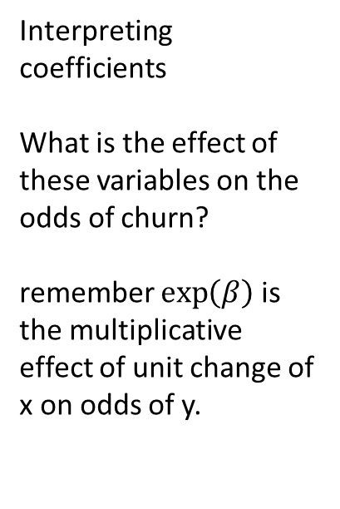
Interpreting coefficients
What is the effect of these variables on the odds of churn?
remember $\exp\left(β\right)$ is the multiplicative effect of unit change of x on odds of y.

Slide 25
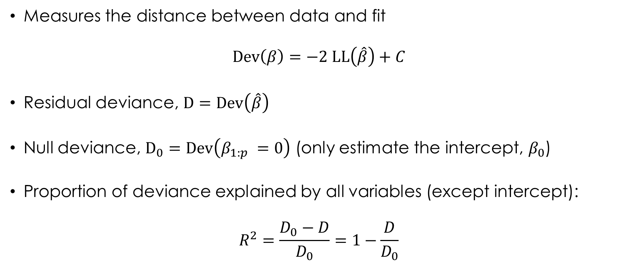
Deviance
Measures the distance between data and fit
$$\text{Dev}\left(β\right)=−2 LL\left(\hat{β}\right)+C$$
Residual deviance, $D=\text{Dev}\left(\hat{β}\right)$
Null deviance, $D_{0}=\text{Dev}\left(β_{1:p} =0\right)$ (only estimate the intercept, $β_{0}$)
Proportion of deviance explained by all variables (except intercept):
$$R^{2}=\frac{D_{0}−D}{D_{0}}=1−\frac{D}{D_{0}}$$
Notes:
compare to likelihood, deviance want to minimize

Slide 26
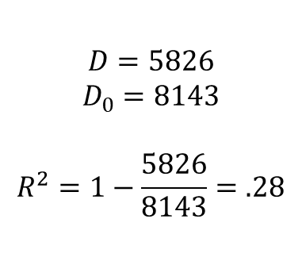
$$D=5826$$
$$D_{0}=8143$$
$$R^{2}=1−\frac{5826}{8143}=.28$$
Notes:
proportion of deviance explained

Slide 27
In-sample vs. out-of-sample
So far we’ve calculated deviance and R² using the same data we used to fit the model: in-sample
But, all that matters is how well the model predicts new data, out-of-sample.
Why is “new data” so important here?
Generalizeability (external validity) = the ability of the results from one data set to carry over to other data sets?
Reading: Blattberg, Kim and Neslin (2008) 11.4

Slide 28
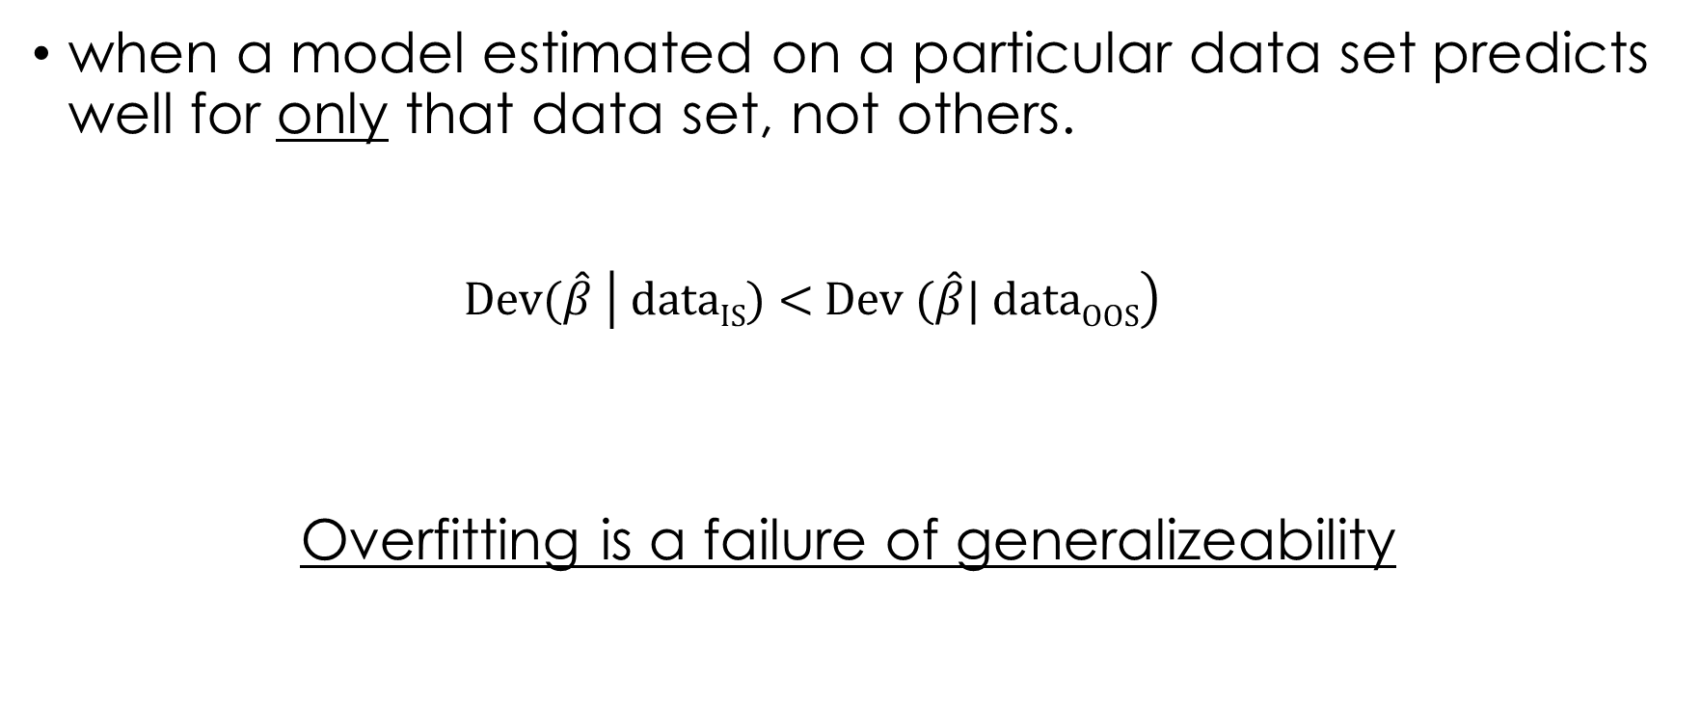
Overfitting
when a model estimated on a particular data set predicts well for only that data set, not others.
$$\text{Dev}\text{(}\hat{β} \left| \text{data}\text{IS}\text{) < }\text{Dev}\text{ (}\hat{β}\text{| }\text{data}\text{OOS}\right)$$
Overfitting is a failure of generalizeability

Slide 29
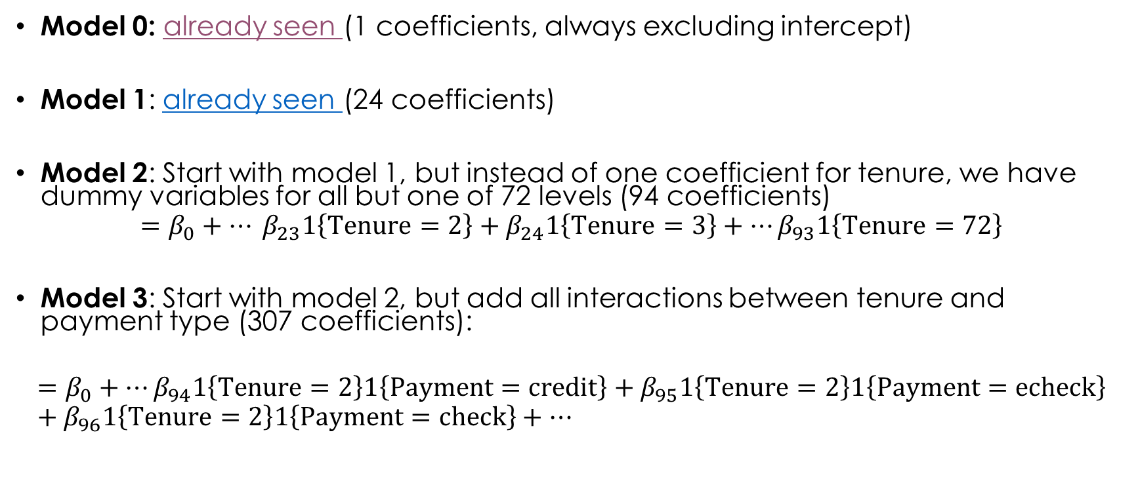
Example
Model 0: already seen (1 coefficients, always excluding intercept)
Model 1: already seen (24 coefficients)
Model 2: Start with model 1, but instead of one coefficient for tenure, we have dummy variables for all but one of 72 levels (94 coefficients)
$$=β_{0}+… β_{23}1\left\{\text{Tenure}=2\right\}+β_{24}1\left\{\text{Tenure}=3\right\}+…β_{93}1\left\{\text{Tenure}=72\right\}$$
Model 3: Start with model 2, but add all interactions between tenure and payment type (307 coefficients):
$$=β_{0}+…β_{94}1\left\{\text{Tenure}=2\right\}1\left\{\text{Payment}=\text{credit}\right\}+β_{95}1\left\{\text{Tenure}=2\right\}1\left\{\text{Payment}=\text{echeck}\right\}+β_{96}1\left\{\text{Tenure}=2\right\}1\left\{\text{Payment}=\text{check}\right\}+…$$

Slide 30
Notes:
More coefficients higher in-sample R2

Slide 31
Out-of-sample
We mimic “new data” by holding out a part of the data.
Fit the model on one part, see how well it does on another part.

Slide 32
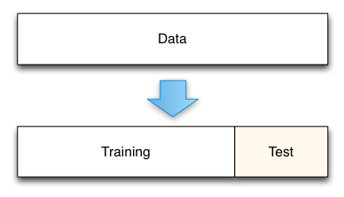
Cross-validation
Simplest method: randomly split data into two parts:
“Training” (in-sample, calibration) = use this to fit model (typically 70-80%)
“Testing” (out-of-sample validation) = use this to make predictions

Slide 33
Problems
Efficiency: some of the data is not used in model fitting, and maybe can be thought of as wasted
Stability: what if, by chance, the validation sample is full of outliers?

Slide 34
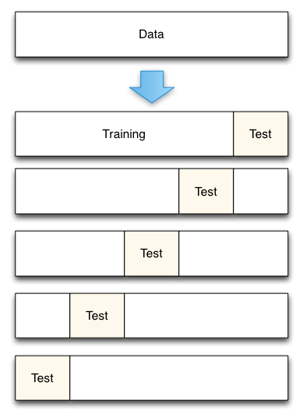
K-fold cross validation
Here K = 5.
Data randomly split into 5 equally sized groups of 20% each.
4 groups used to fit, one group to validate.
Repeat so that all data is used.
We now have a sample of K OOS R²

Slide 35
Notes:
Negative even

Slide 36
Bad
predictions
OOS error
Deviance
= overfitting
Good
predictions
IS error
Optimal
Simple
Complex
Model Complexity

Slide 37
Other diagnostics

Slide 38

Classification (aka “confusion”) matrix
 |  | Predicted*
 |  | 0 | 1
Observed | 0 | True Negative (TN) | False Positive (FP)
 | 1 | False Negative (FN) | True Positive (TP)
% correct
TN / (TN + FP)
TP / (TP + FN)
$\text{Predicted}=1 if p_{i}>\overline{p}$ usually ($\overline{p}=0.5)$
Accuracy = (TP + TN) / Total
“Hit Rate” = “Sensitivity” = True positive rate = TP / (TP + FN)
“Specificity” = True negative rate = TN / (TN + FP)
Notes:
classification is turning probabilities into 0/1

Slide 39
Classification matrix
 |  | Predicted*
 |  | 0 | 1
Observed | 0 | 1167 | 119
 | 1 | 208 | 270
% Correct
90.7
56.5
Accuracy = 81.5%

Slide 40
ROC curve generalizes all cutoffs
An ideal model will have a perfect true positive rate with no false positive rate
ROC curve will hug the top left corner
A bad model will make the same predictions for everyone, giving the diagonal line
Reading: Blattberg, Kim and Neslin (2008) Ch 11
Notes:
By predicting everyone is positive you can have a 100% sensitivity
By predicting everyone is negative you can have a 100% specificity

Slide 41
Area under the curve (AUC)
AUC is a measure of how well the model distinguishes between two classes
One way of interpreting AUC is as the probability that the model ranks a random positive example more highly than a random negative example
Reading: Blattberg, Kim and Neslin (2008) Ch 11.
Notes:
By predicting everyone is positive you can have a 100% sensitivity
By predicting everyone is negative you can have a 100% specificity

Slide 42

Lift
To get the “biggest bang for the buck”, the marketer who can afford to target n persons picks the n highest-probability customers as targets.
Basic idea:
Based on predictions: pick top 10%, top 20%, … all 100%...
what % of churners will I get?
rank according to model, from most likely to least likely.
$$λ_{1}=\frac{r_{1}}{\overline{r}}$$
Churn rate in top decile
Churn rate in entire sample
(.27)
Reading: Blattberg, Kim and Neslin (2008) Ch 10.3.4

Slide 43
Lift
decile | actual churn rate | lift | cumulative lift
10 | 0.7684 | 2.8355 | 28.4
9 | 0.6250 | 2.3065 | 51.5
8 | 0.4350 | 1.6054 | 67.5
7 | 0.3466 | 1.2791 | 80.3
6 | 0.2500 | 0.9226 | 89.5
5 | 0.1412 | 0.5212 | 94.8
4 | 0.0795 | 0.2936 | 97.7
3 | 0.0395 | 0.1459 | 99.2
2 | 0.0227 | 0.0839 | 100.0
1 | 0.0000 | 0.0000 | 100.0
To get the “biggest bang for the buck”, the marketer who can afford to target n persons picks the n highest-probability customers as targets.
Basic idea:
Based on predictions: pick top 10%, top 20%, … all 100%...
what % of churners will I get?
rank according to model, from most likely to least likely.
Highest p
Lowest p
Reading: Blattberg, Kim and Neslin (2008) Ch 10.3.4
Notes:
Customers in the top decile are nearly 3 times more likely to churn than average.
Customers in the top 3 decile have 67.5% of all churners

Slide 44
The top 3 deciles account for 67% of all churners
If I randomly selected 30% of ALL customers, I would expect to see 30% of ALL CHURNERS

Slide 45
Logistic regression for proactive targeting
How many deciles should we target?

Slide 46
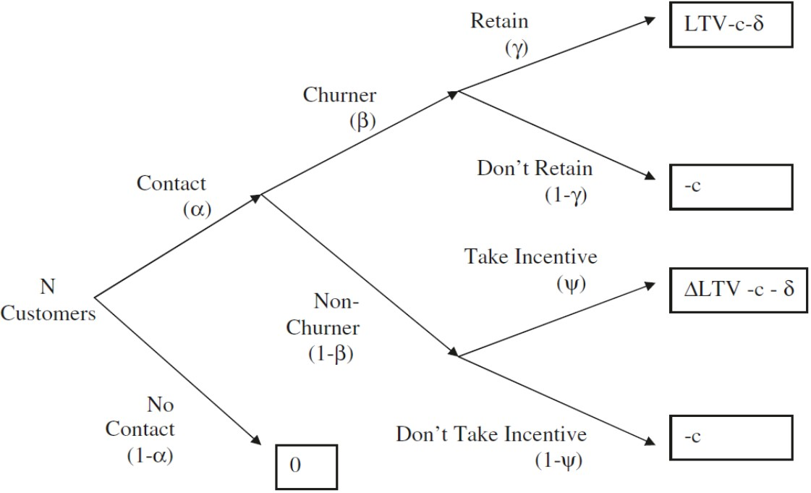
BKN 24.4.2
α proportion contacted
β proportion churners contacted
γ proportion rescued if a churner
c cost of contacting
δ cost of incentive to stay
LTV lifetime value of customer
ψ proportion non-churner takes incentive = 1
Δ percent increase in LTV of non-churners = 0

Slide 47
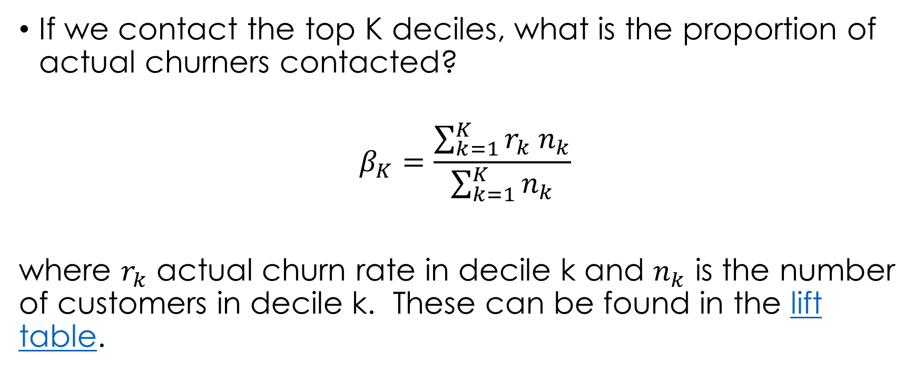
proportion
If we contact the top K deciles, what is the proportion of actual churners contacted?
$$β_{K}=\frac{\sum_{k=1}^{K }{r_{k} n_{k}}}{\sum_{k=1}^{K }{n_{k}}}$$
where $r_{k}$ actual churn rate in decile k and $n_{k}$ is the number of customers in decile k. These can be found in the lift table.

Slide 48

profits
$$Π=N α \left(β γ \left(LTV −δ−c\right)−β\left(1−γ\right)\left(c\right)−\left(1−β\right)\left(δ+c\right)\right) \\ =N α \left(β \left(γ LTV+δ \left(1−γ\right)\right)−δ−c\right)$$
choose $α∈\left\{.1, .2, .. 1\right\}$to maximize $Π$

Slide 49
γ proportion rescued if a churner = 0.10
c cost of contacting = 0.50
δ cost of incentive to stay = 50
LTV lifetime value of customer = 500

